Slide 1

Intro to Java Day 2- More Java Syntax
By: Nishant Malpani

Slide 2
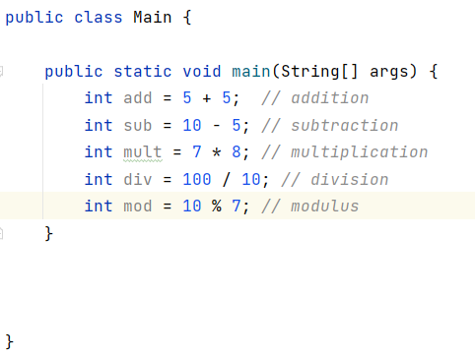
Arithmetic Operators in Java
Just like math, you can do all arithmetic operations in Java!
You are probably familiar with all of the operators except for modulus. However, there are a few interesting things we will see.
As a reminder, modulus is the remainder of a division problem, and is represented by the percentage sign in java. As an example, 10 % 7 equals 3.

Slide 3
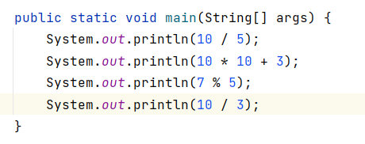
Let’s do some practice!
Take a minute and evaluate the following problems. We will discuss them as a group once you are done.

Slide 4
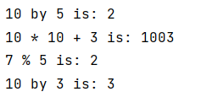
Answers!
How did your answers compare with these? Notice anything weird with the last one….?

Slide 5

What happened with the division?
Notice how 10 / 3 = 3, according to Java. However, we know that 10 divided by 3 is actually 3.33…! Why is Java saying that the answer is 3?
Does anyone have a guess for why?

Slide 6
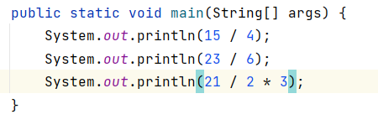
What happened with the division?
The reason is because Java spits out the answer as an integer, and integers cannot have decimals. So what Java does is it does the division, excludes the reminder, and answers with what the whole number is. Let’s look at some more examples.
What do you think the following will be?

Slide 7

What happened with the division?
Is this what you got?

Slide 8
Casting
What if we don’t want the decimal places to be cut off?
To do this, we have to cast the operators to a different type that includes decimal points. Casting is when you assign the value of one primitive data type to another data type.
Does anyone recall what primitive type in Java supports this?
Floats and Doubles! If we cast the numbers in the operations to either a float or double, the decimal places will not get cut off.
Notes:
Possibly add animation

Slide 9
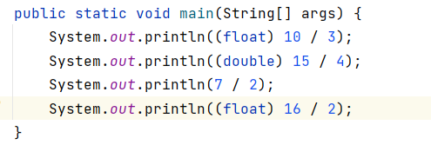
Casting
Let’s look at an example. What will the following will output?
Notes:
Possibly add animation

Slide 10
Casting
Let’s look at an example. What will the following will output?
Notes:
Possibly add animation

Slide 11
Casting
Is this what you got? Why does the answer to #3 have no decimal point, and why does the answer to 4 have a decimal point?
1)3.3333333
2)3.75
3)3
4)8.0
Let’s take a minute to understand each of these answers. Casting can be confusing, and it is a slightly more advanced concept so don’t stress if you aren’t fully grasping them on your first day!
Notes:
Possibly add animation

Slide 12
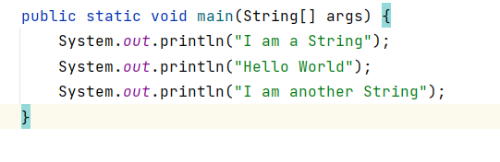
Strings
Do you guys remember what strings are? Can someone share and remind us what a String is in Java?
A String is a one of Java’s primitive types- it can store a set amount of characters. Remember, a String is made up of multiple characters.
Notes:
Do an animation between the question and answer

Slide 13
String vs Character
What is the difference between a String and a Character? Can someone remind us?
While both Strings and Characters are primitive types in Java, Characters can only store a unique character (one character), while Strings can store multiple characters
Remember- Strings are defined by double quotes, while Characters are defined by single quotes
Notes:
Do an animation between the question and answer

Slide 14
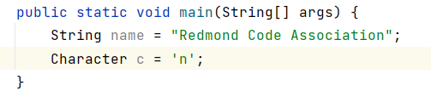
String vs Character
Take a minute and practice making a few of your own Strings and Characters!
Notes:
Do an animation between the question and answer

Slide 15
String Concatenation
String Concatenation… that sounds like a complicated thing! Don’t worry- it’s really simple!
String concatenation is when you add multiple Strings together to make a combined String!
Wait… you can do that???
Yeah, you can and it’s just like math! Let’s look at a few examples together.
Notes:
Do an animation between the question and answer

Slide 16
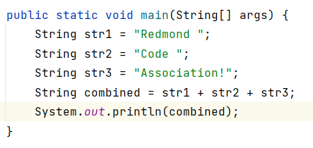
String Concatenation
What do you think the example below will output?
Notes:
Do an animation between the question and answer

Slide 17
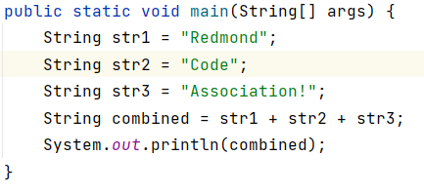
String Concatenation
If you guessed “Redmond Code Association!” you are correct!
Notice how space was added at the end of the words Redmond and Code. If space wasn’t added- what do you think would happen?
Notes:
Do an animation between question and visual

Slide 18
String Concatenation
The compiler will output “RedmondCodeAssociation!”.
Concatenation is very useful- but it’s important to use spaces when applicable. Java will read your code line by line and won’t make any assumptions about whether you want a space or not- so be careful!
Notes:
Do an animation between question and visual

Slide 19
String Concatenation
Let’s practice some String Concatenation!
Make three strings: One containing your first name, one containing your last name, and the third containing your favorite food.
Then, make a fourth string which is a concatenation of the three strings and print the fourth string out.
The output of your code should look something like: “Firstname lastname- food!”
Notes:
Do an animation between question and visual

Slide 20
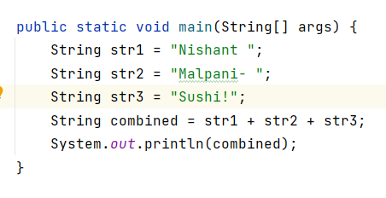

String Concatenation
Did your code work? If not, what went wrong?
Here’s what mine looked like:
Does anyone have any questions on how this works or about String concatenation in general?
Notes:
Do an animation between question and visual

Slide 21
That’s it for today!
Any question? We learned a lot of important fundamental concepts that you will need to master because learning more complex Java concepts!
What we learned:
- Arithmetic Operations
- Casting
- String Concatenation
While it may seem that what we are learning now is boring and useless, it is vital to understand before moving forward. Exciting projects are coming in the near future!
Notes:
Do an animation between question and visual

Slide 22
Thank You For Coming!
Please check out the Redmond Code Association website for more events and resources! (Write something like this at the end of each event)

